Slide 1
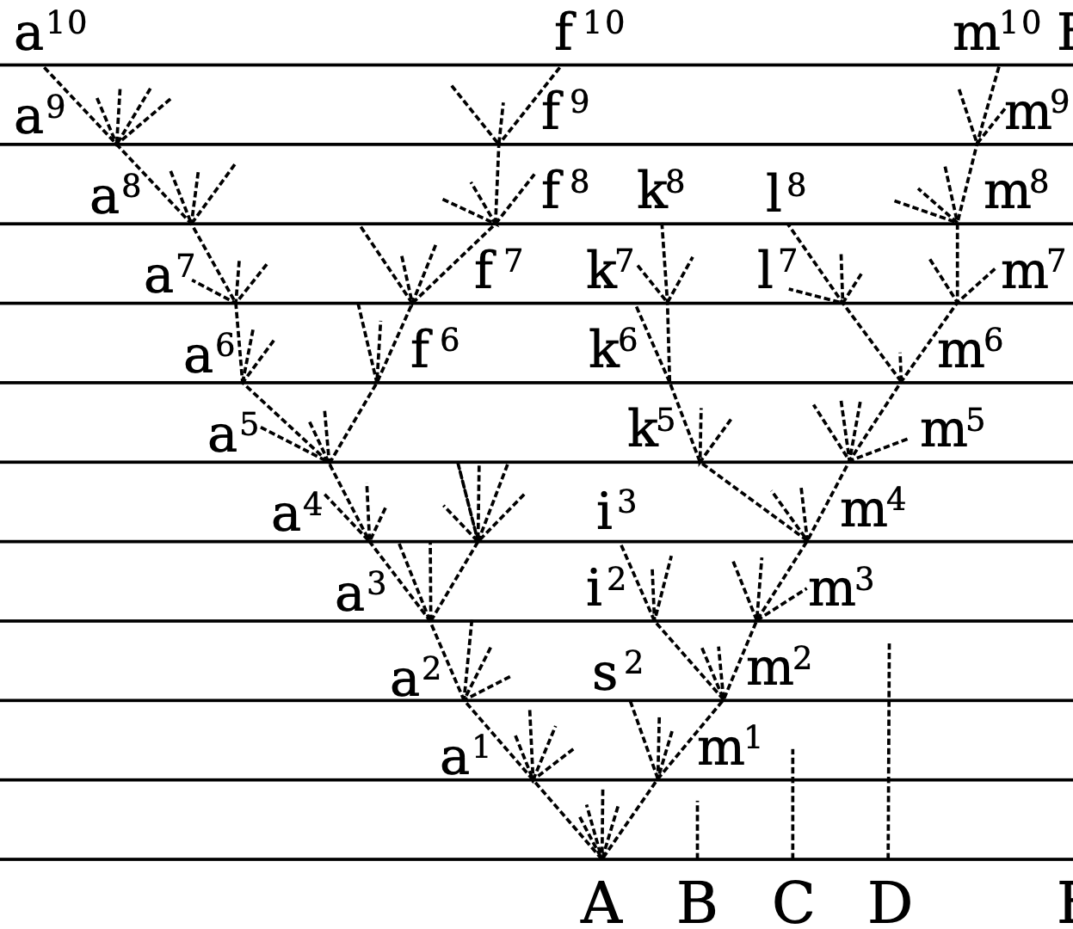
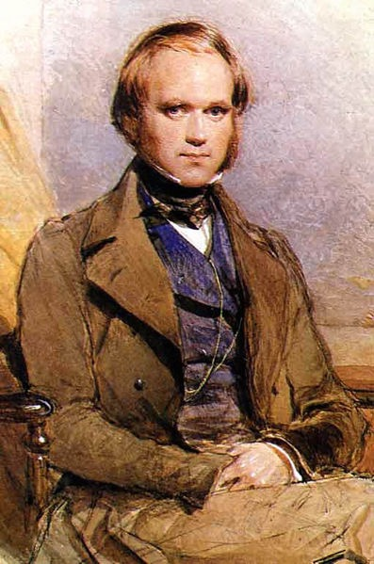
Darwin’s Computer
Detail from the only illustration in the Origin of Species (Darwin, 1859)

Slide 2
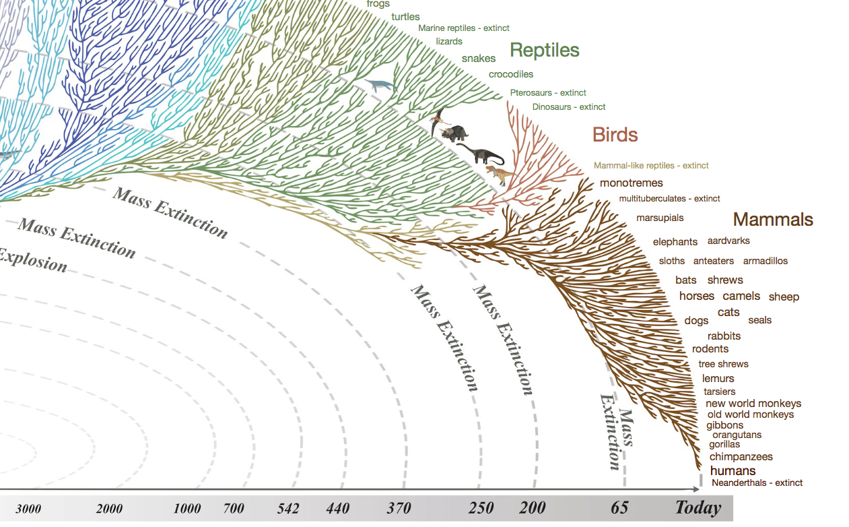
https://www.evogeneao.com/explore/tree-of-life-explorer

Slide 3
Descent with modification in populations

Slide 4
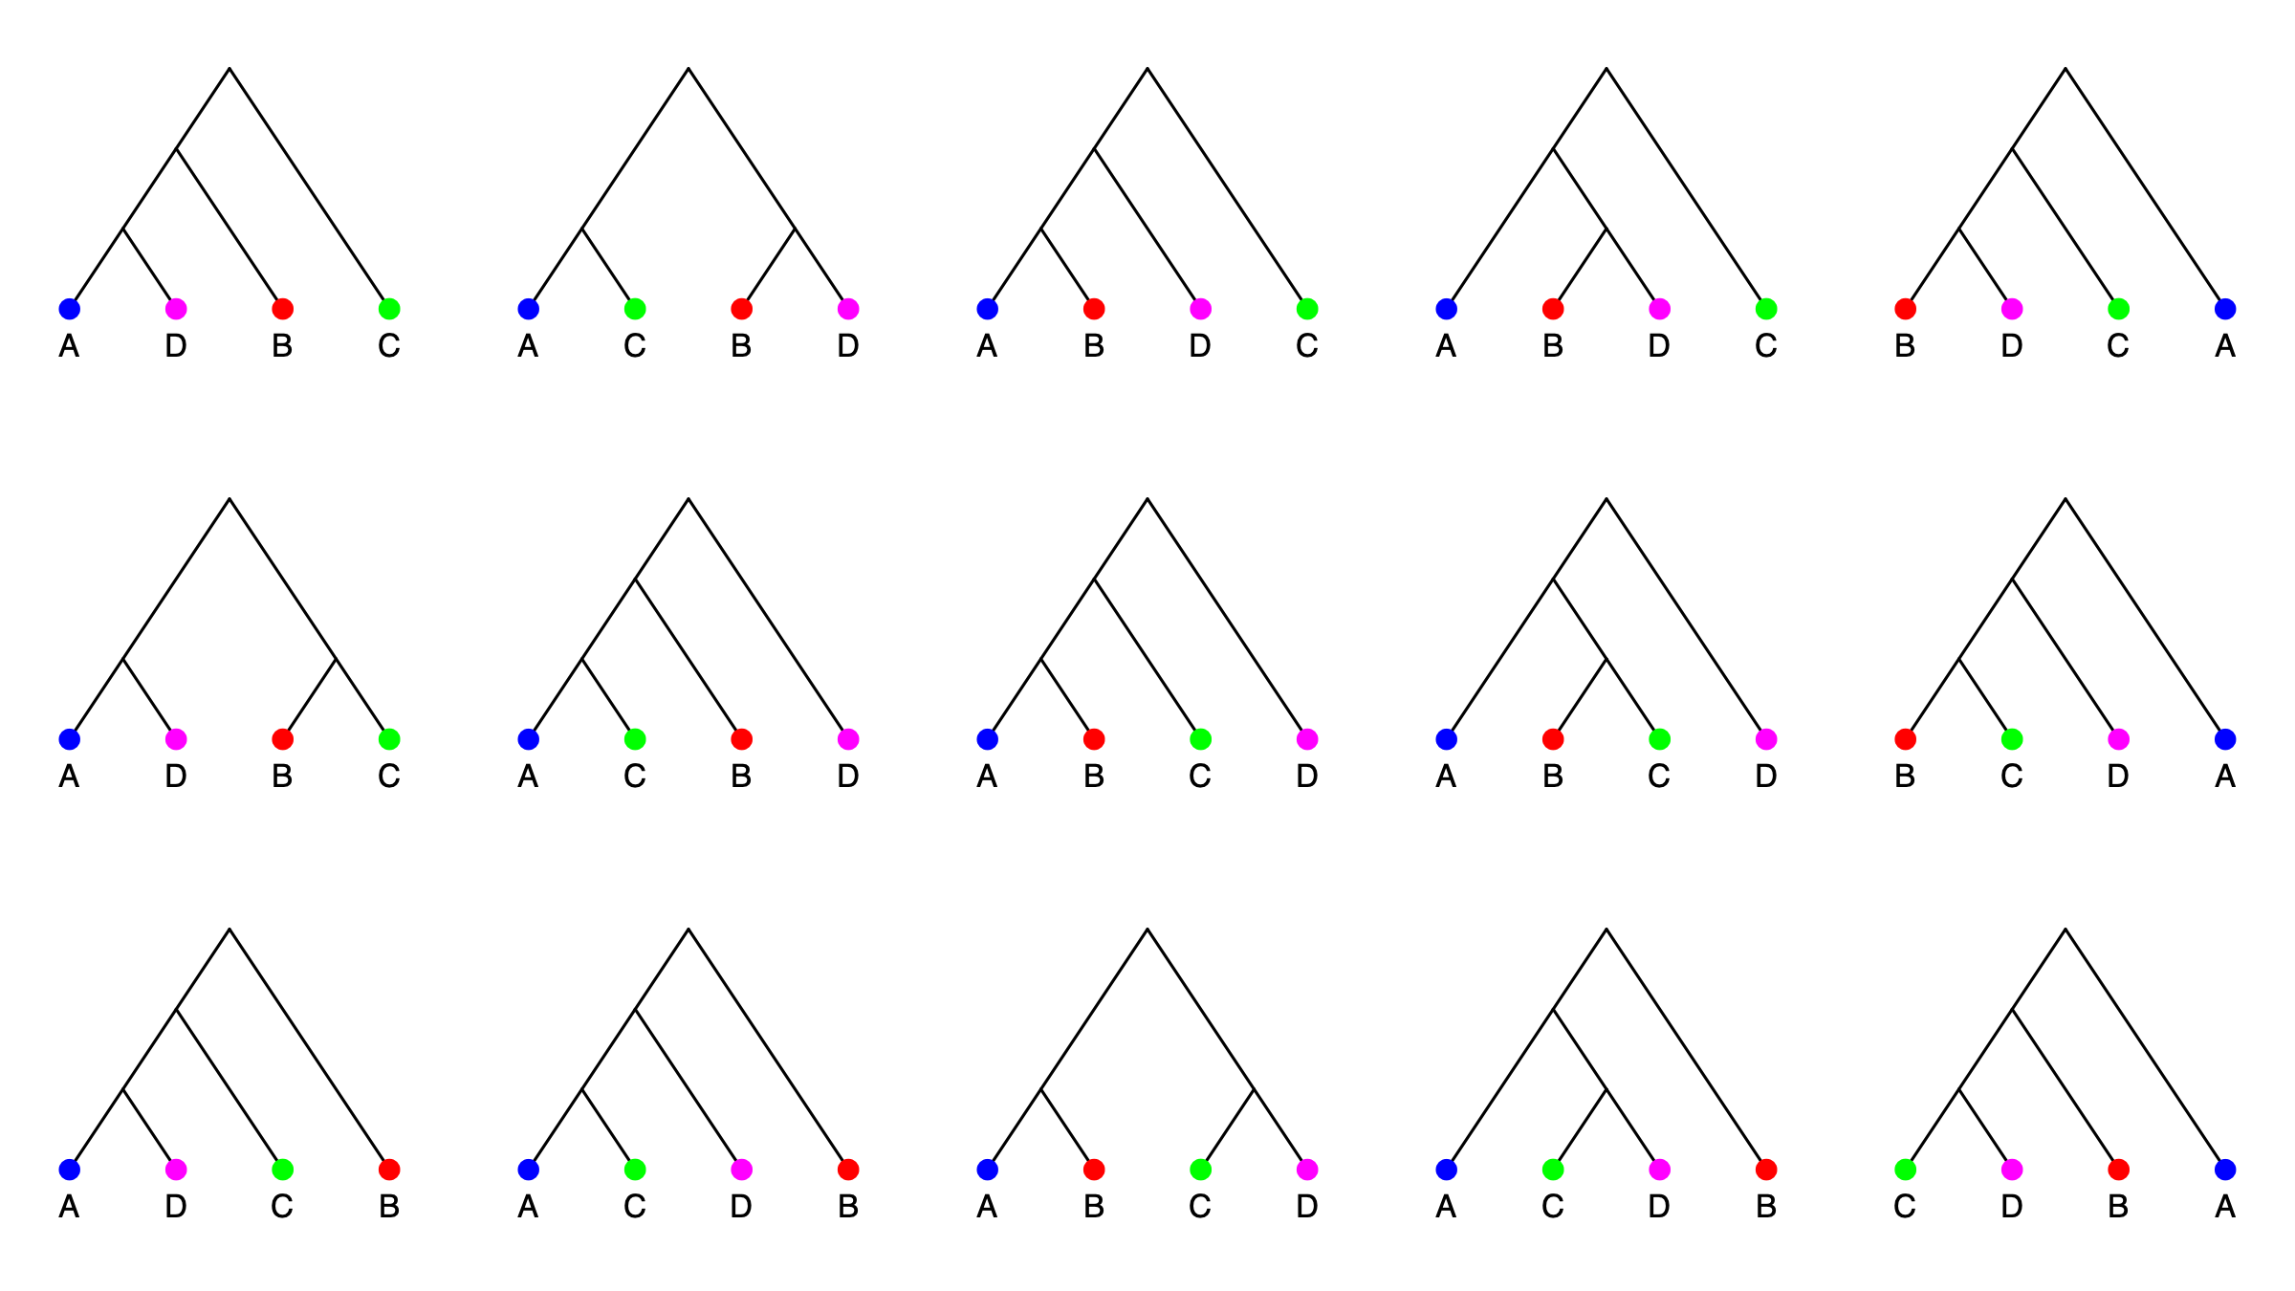
15 possible trees of 4 individuals/species

Slide 5
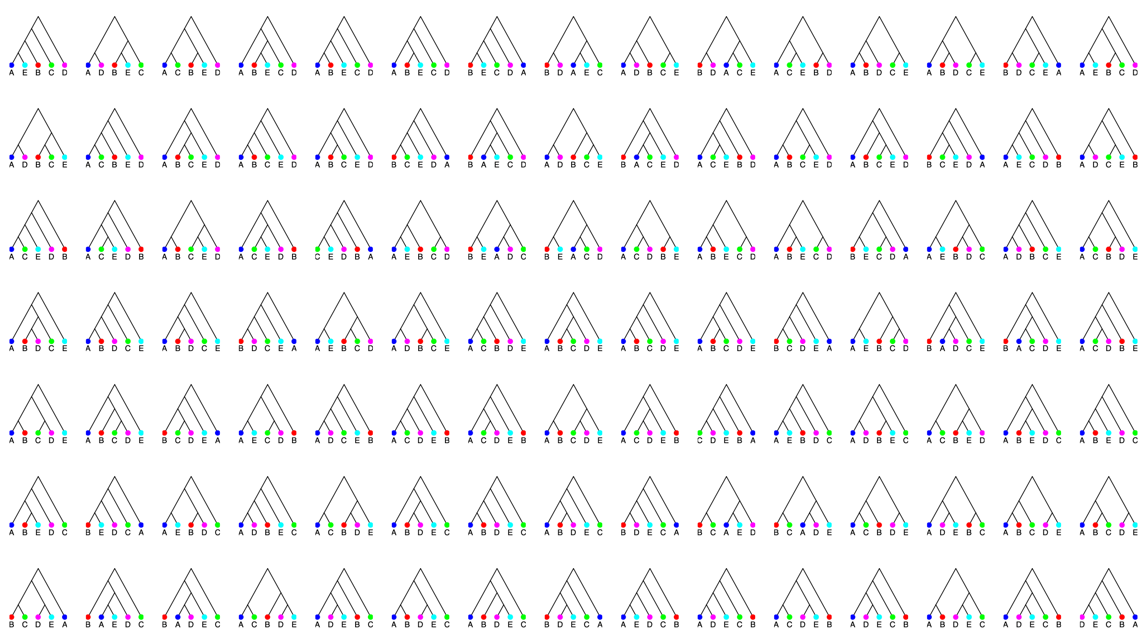
105 possible trees of 5 individuals/species

Slide 6
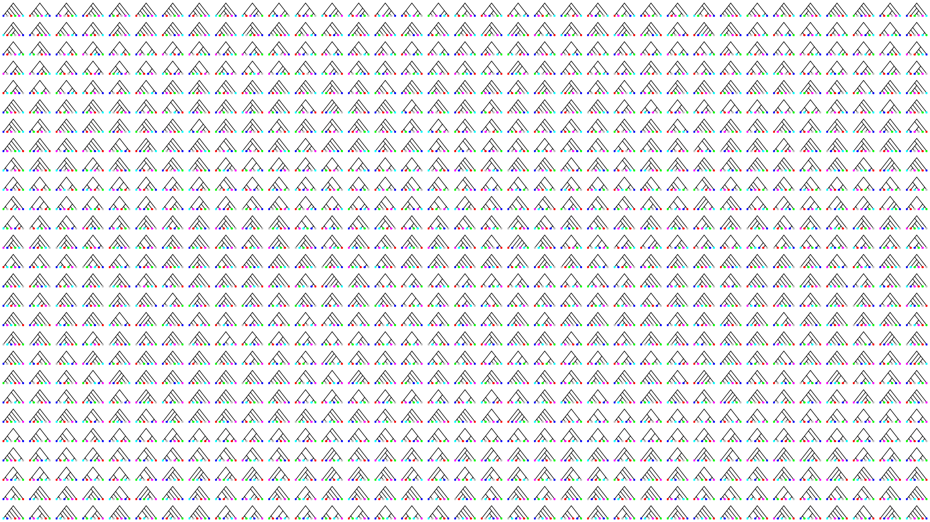
945 possible trees of 6 individuals/species

Slide 7
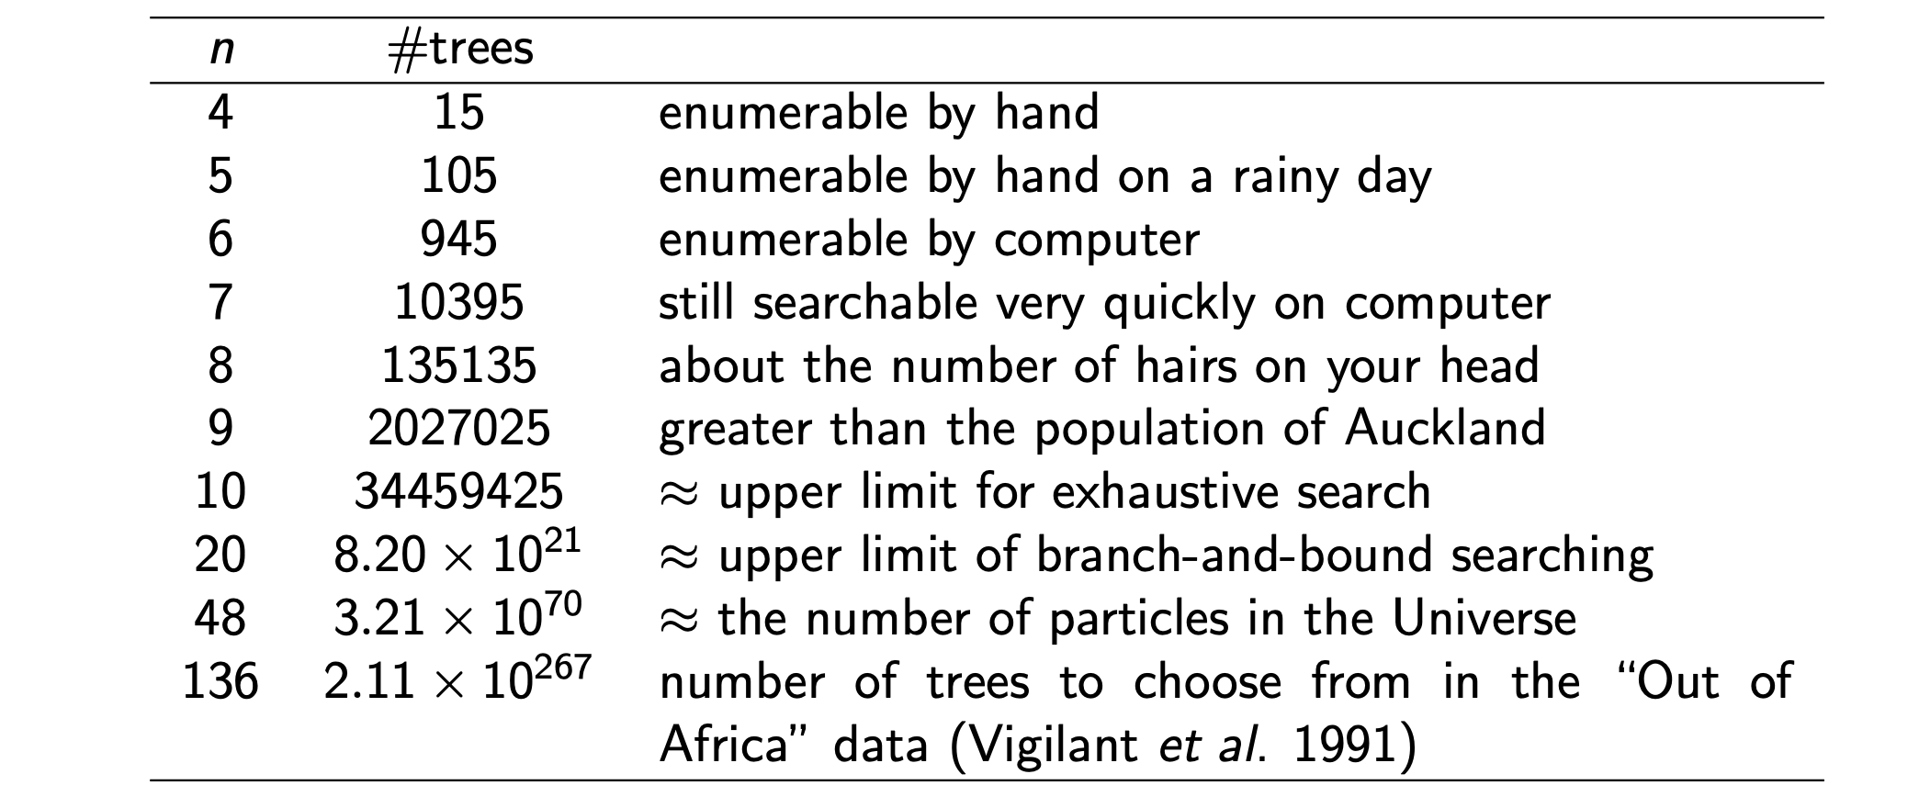
How many trees are there?

Slide 8
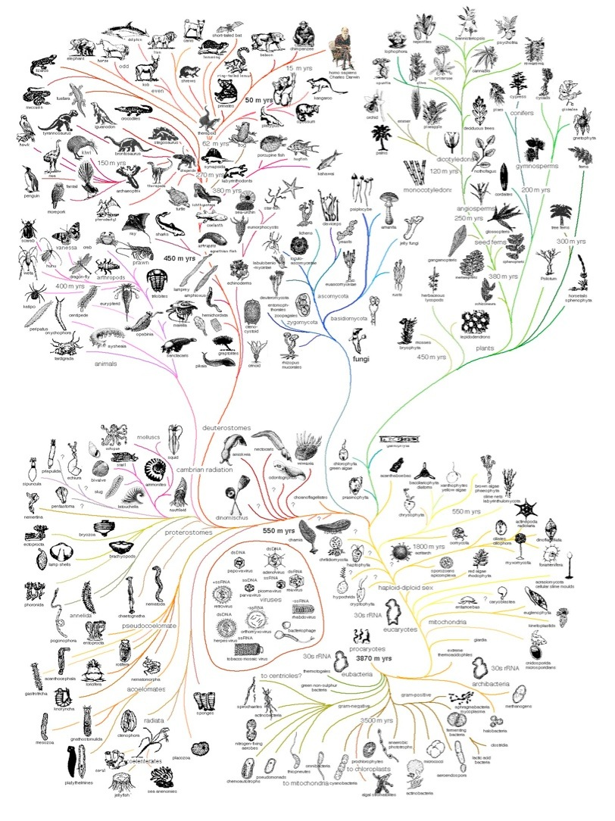
Computing Darwin’s Tree of Life

Slide 9
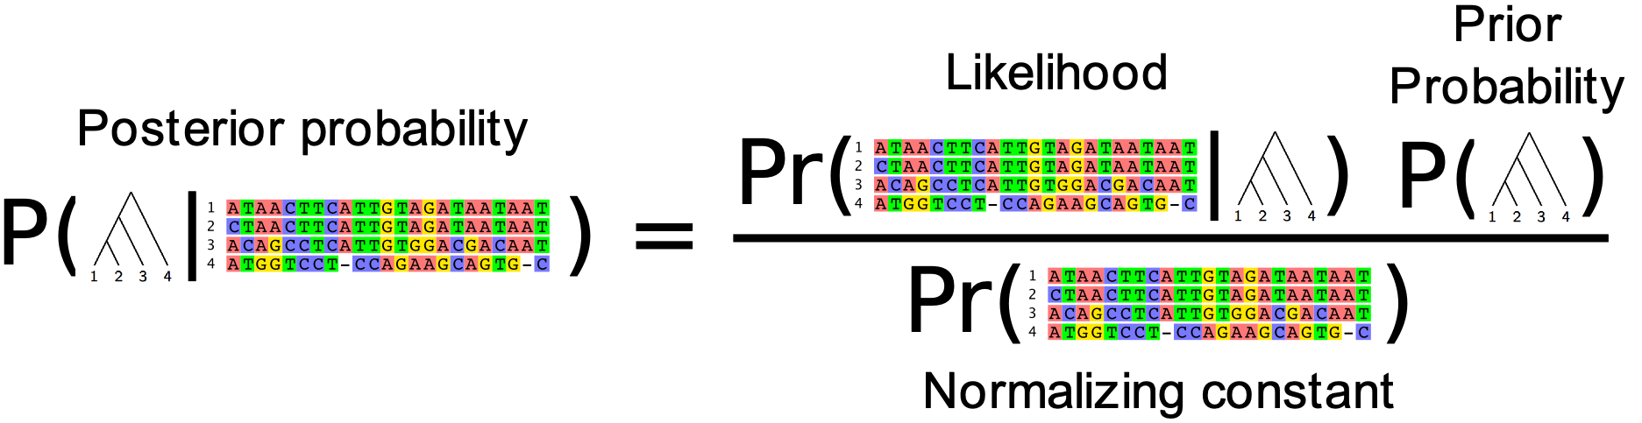
Bayesian reconstruction of phylogenetic trees
Yang & Rannala (1997), Mau, Newton & Larget (1998)
What we really want is the probability of the tree given the data.
We can compute that from the likelihood using Bayes Theorem:
This is known as the Posterior probability of the tree. Using the Markov chain Monte Carlo algorithm we can produce a sample of trees that have high posterior probability.

Slide 10
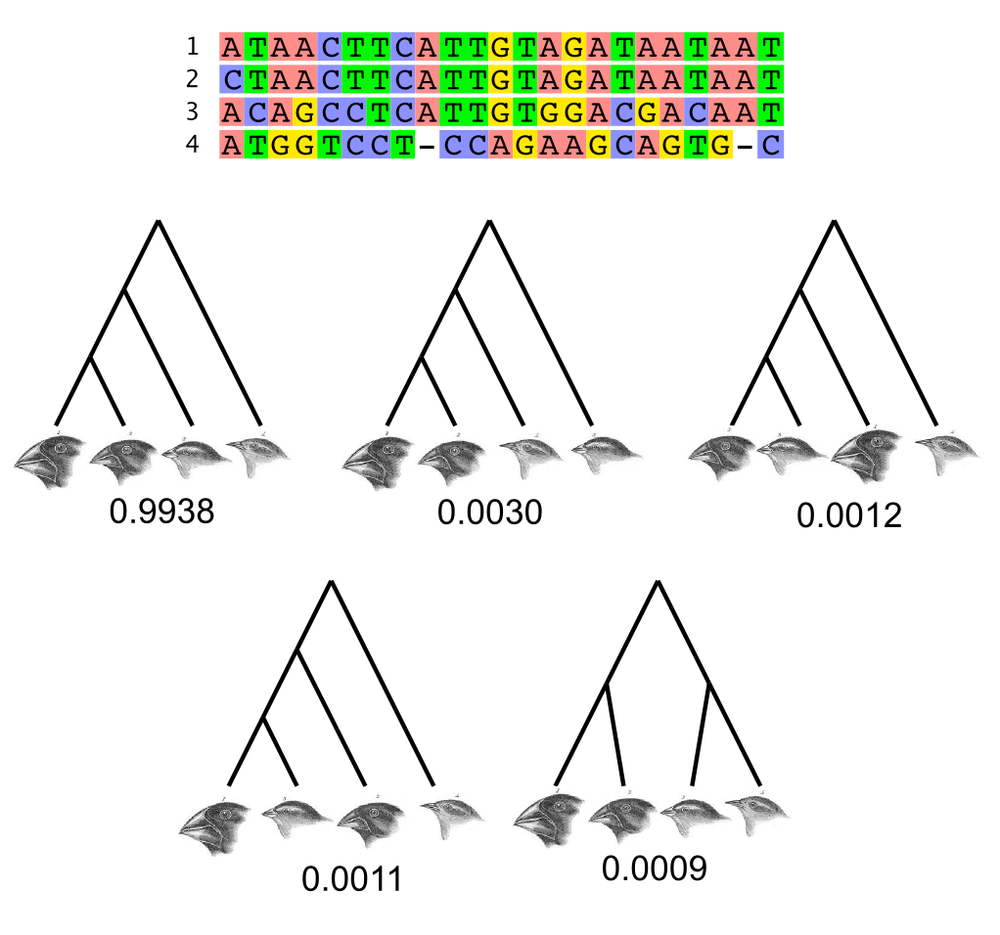
The posterior distribution on Darwin’s Finches
This posterior probability distribution was computed using Markov chain Monte Carlo implemented in the BEAST software package (Drummond et al, 2012).

Slide 11
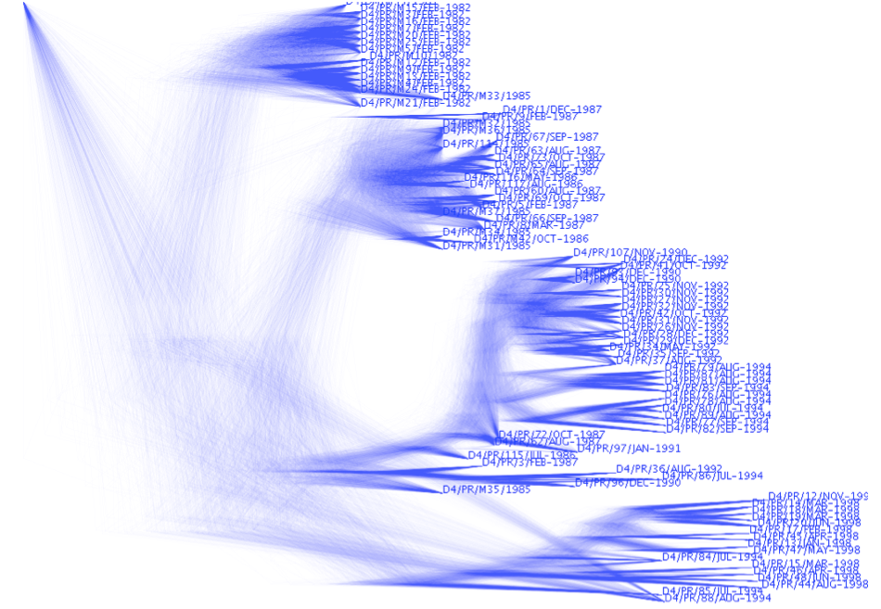
The posterior distribution of larger trees
Produced using DensiTree (Bouckaert, 2012)

Slide 12
Elaborations of the phylogenetic model
Basic model: (posterior proportional to likelihood x prior)
p(T|D) ∝ Pr(D|T) p(T)
Substitution model:
p(T,Q|D) ∝ Pr(D|T,Q) p(T) p(Q)
Substitution model and tree branching process prior:
p(T,Q,Θ|D) ∝ Pr(D|T,Q) p(T|Θ) p(Q) p(Θ)

Slide 13
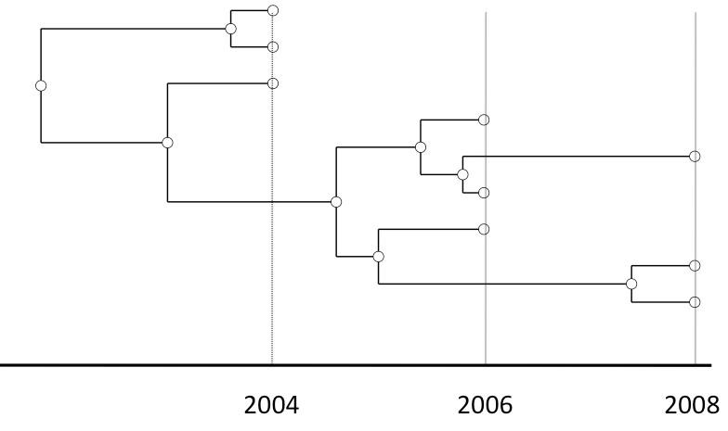
Elaborations of the model: Evolution is happening right now!
Modelling phylogenetic data sampled through time
Drummond and Rodrigo (2000), Drummond et al (2002)
Rapidly evolving microbes
Ancient DNA
Cancer
Somatic evolution
Languages
et cetera
p(T,Q,Θ,μ|D) ∝ Pr{D|μT,Q} p(T|Θ) p(Q)p(Θ)p(μ)

Slide 14
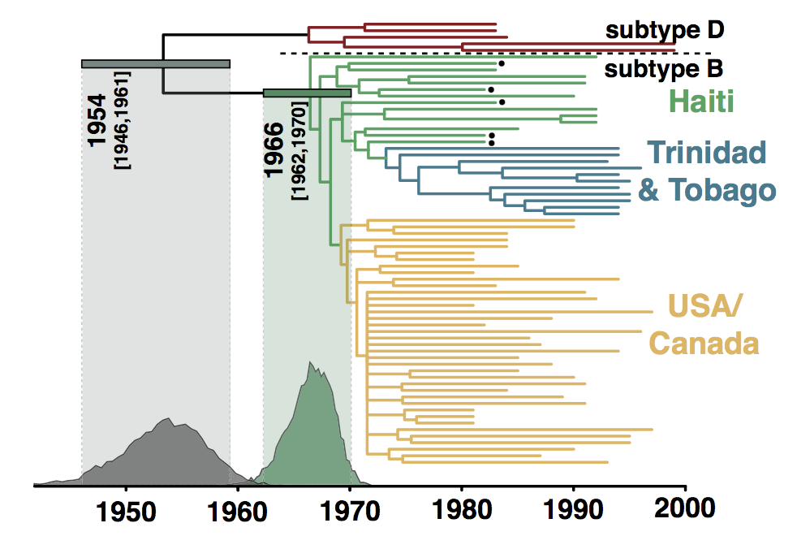
A calibrated phylogenetic inference
Origin of the HIV epidemic in the Americas, Gilbert et al (2007)
A phylogenetic reconstruction of samples of HIV-1 virus. Each tip represents a single infected individual from whom a blood sample has been taken.

Slide 15

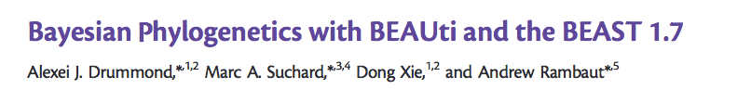
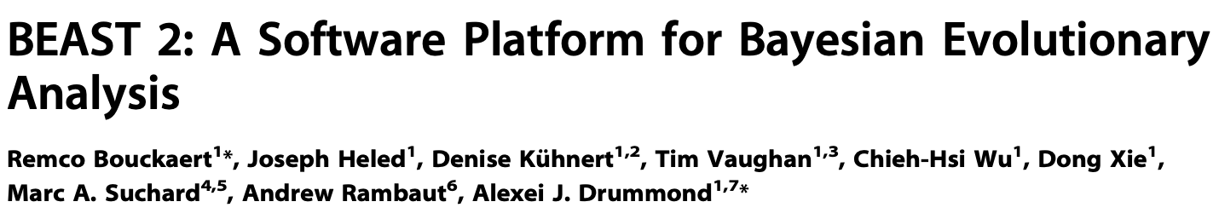
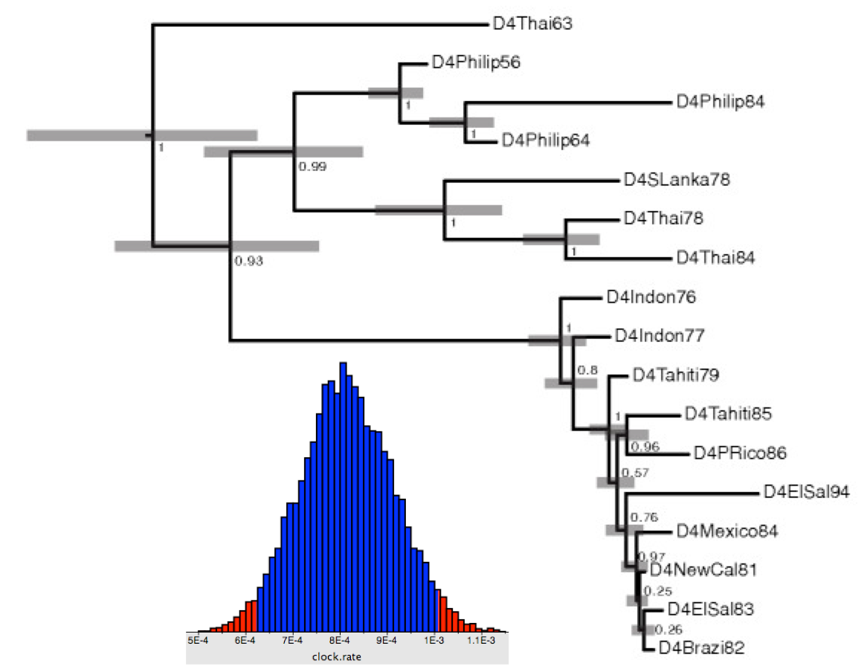
BMC Evol Biol, 2007
Mol Biol Evol, 2012
PLoS Comp Bio, 2014
Estimation of
evolutionary trees
divergence times
evolutionary rates
evolutionary model parameters
population history
infectious disease parameters
migration rates
more…
>10,000 scientific studies have used this software since 2007;
> 2,500 studies last year alone (2016)

Slide 16
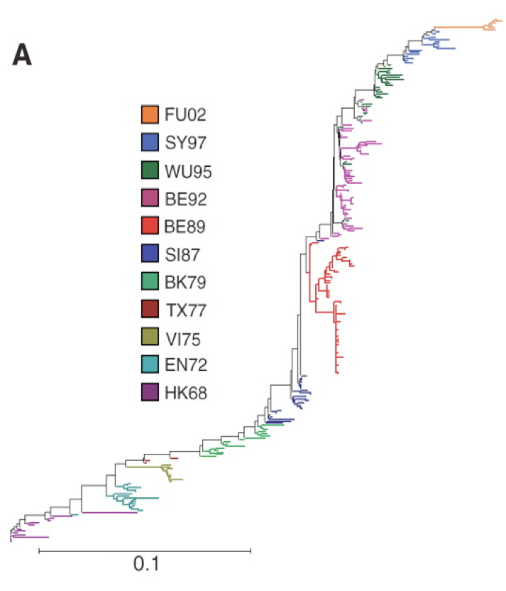
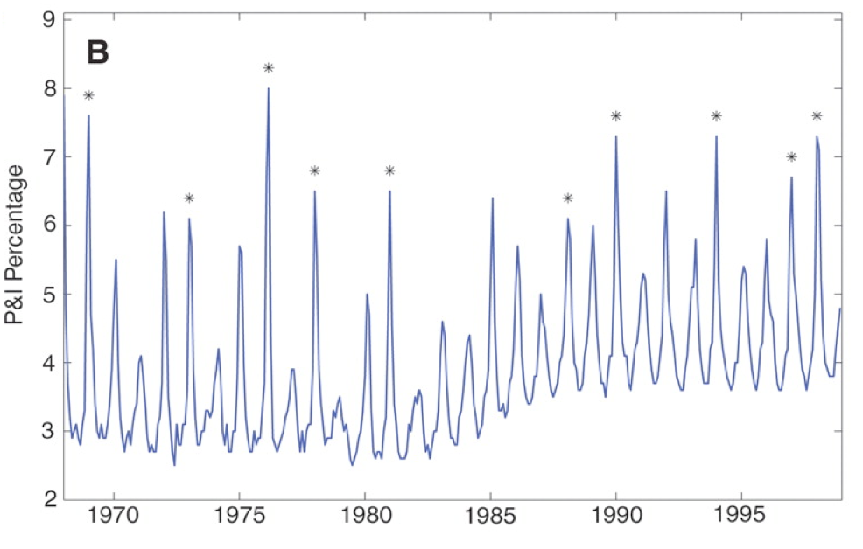
Phylodynamics
Statistical phylogenetics and population genetics models
Mathematical epidemiology, non-linear dynamical models
Goal: the integration of immunological, genomic and epidemiological data in a single coherent predictive model.

Slide 17
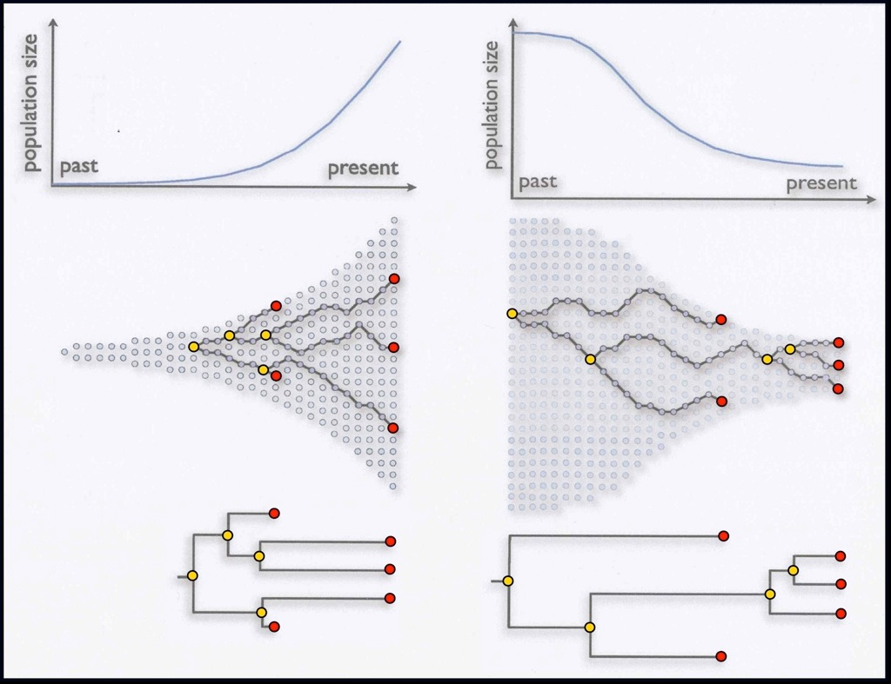
Coalescent theory: p(g|Θ)
Θ
Kingman’s coalescent
g
p(g,Q,Θ|D) ∝ Pr{D|μg,Q} p(g|Θ) p(Q) p(Θ)

Slide 18
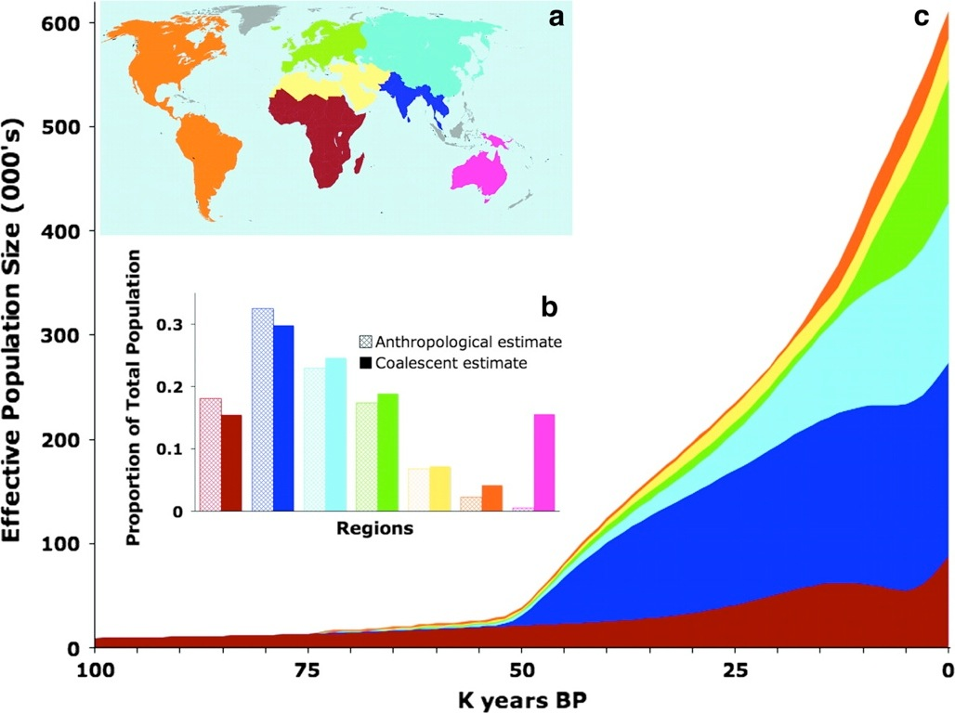
Mitochondrial DNA Variation Predicts Population Size in Humans and Reveals a Major Southern Asian Chapter in Human Prehistory
Atkinson, Gray and Drummond, 2008, Molecular Biology and Evolution

Slide 19
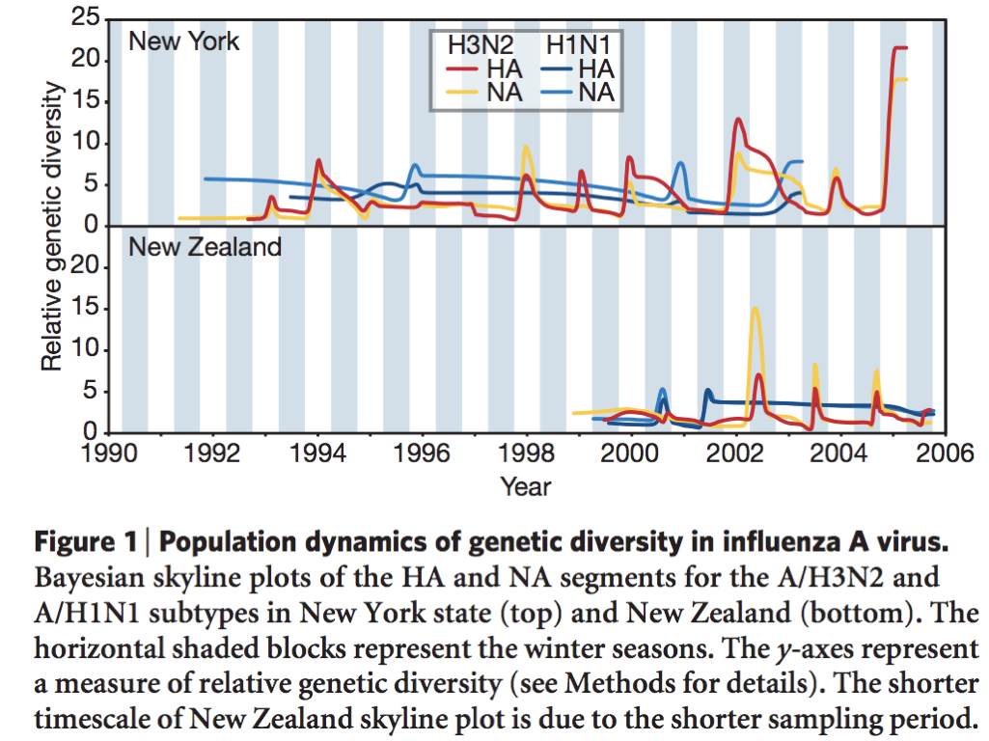
Estimating seasonal outbreaks from flu sequences
Rambaut et al (2008)

Slide 20
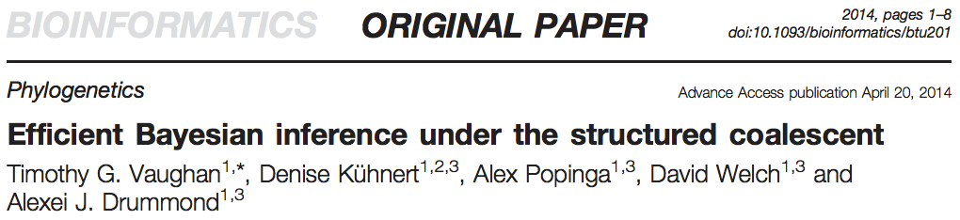
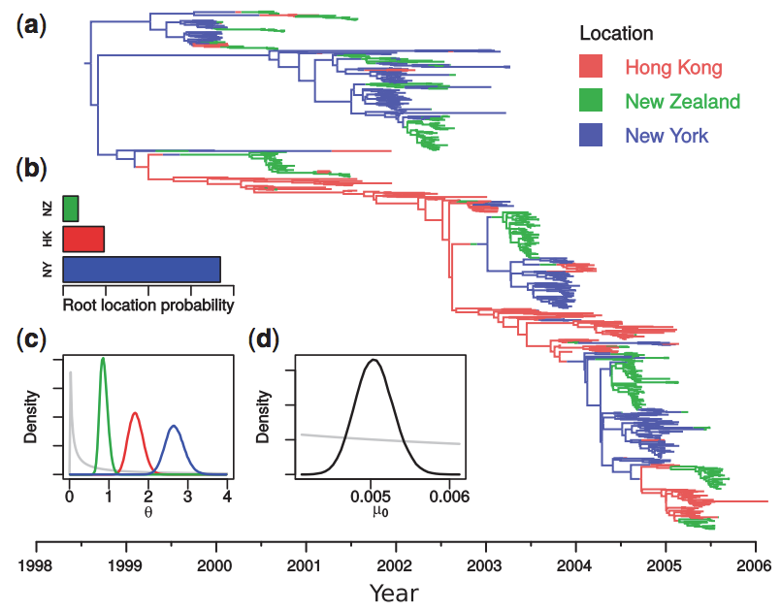
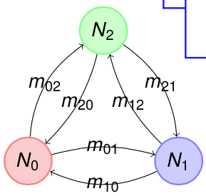
Evolution provides a record of influenza’s global dynamics
~10,000,000 nucleotides

Slide 21
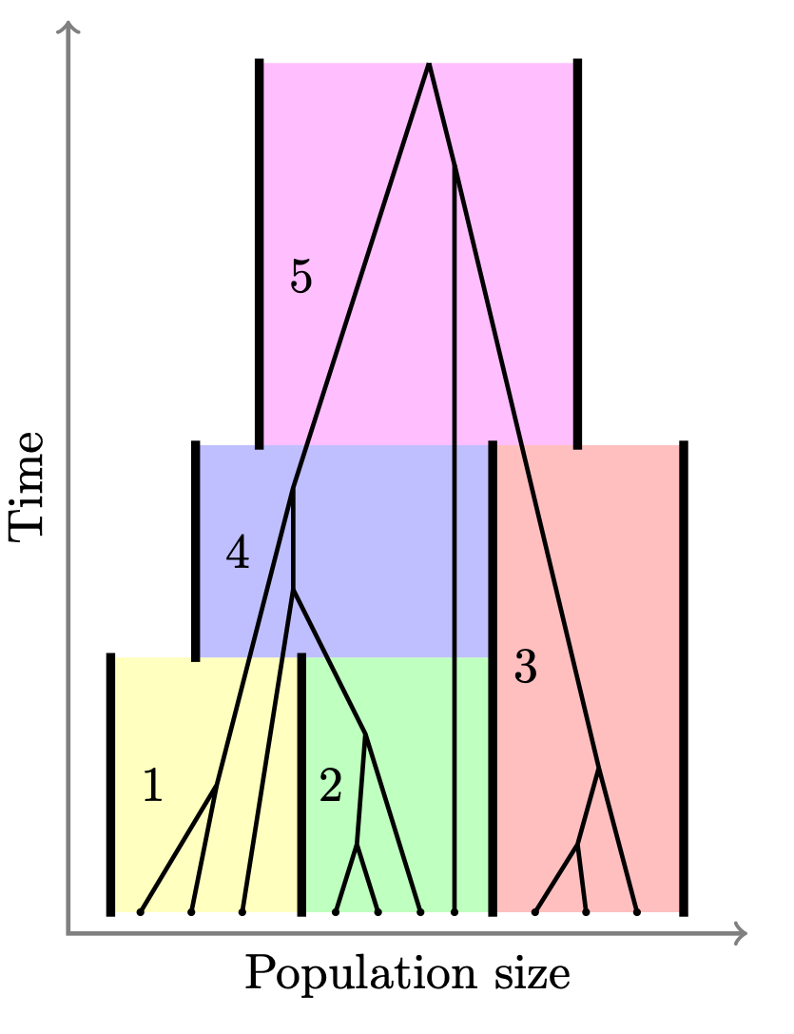
Trees inside trees
Modelling diversity and divergence
Central to understanding diverse areas including speciation genomics and host-symbiont co-evolution is building up a statistically rigorous model of the patterns of divergence and diversity spanning multiple species/hosts, multiple genes / gene families and multiple individuals per species/host.
p(T,S|D) ∝ Pr{D|T} p(T|S) p(S)
p(t1,t2,...,tN,S|D) ∝ ∏i Pr{Di|ti} p(ti|S) p(S)

Slide 22

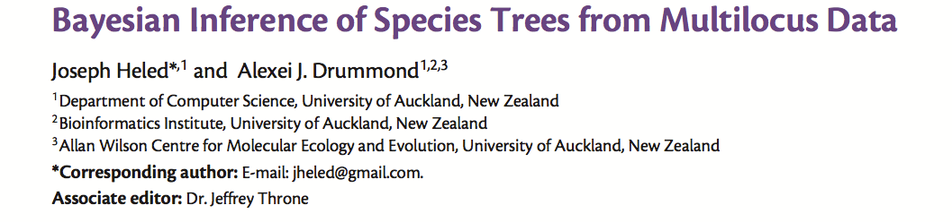
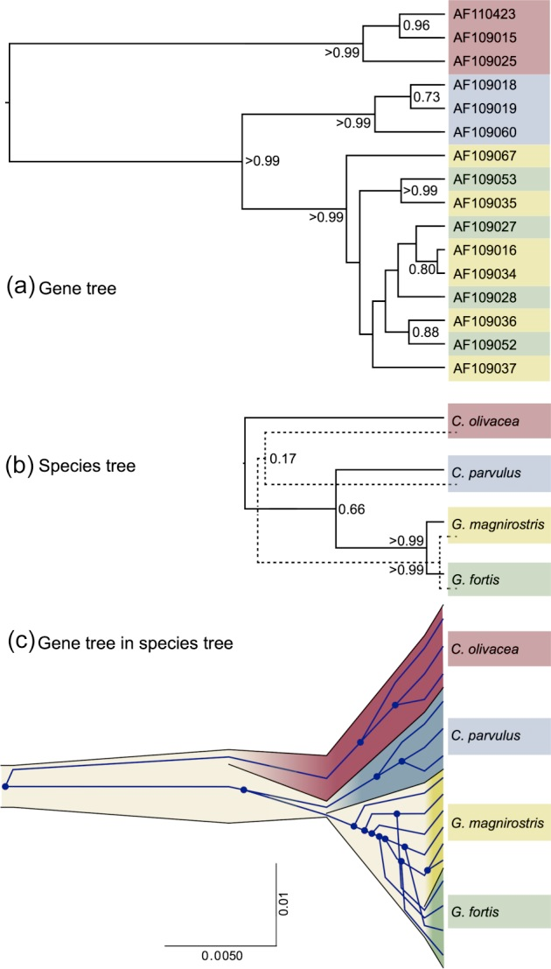
Molecular Biology and Evolution, 2010
The multispecies coalescent is a fundamental statistical model for explaining the relationship between a “gene tree” and a “species tree”.
Admits incomplete lineage sorting as the only cause of incongruence.
Forms a theoretical basis for models that estimate species boundaries based on genomic data.
Forms a theoretical basis for elaborations of phylogenomic models that include additional confounding factors: lateral gene transfer, admixture, hybridisation, gene flow.

Slide 23
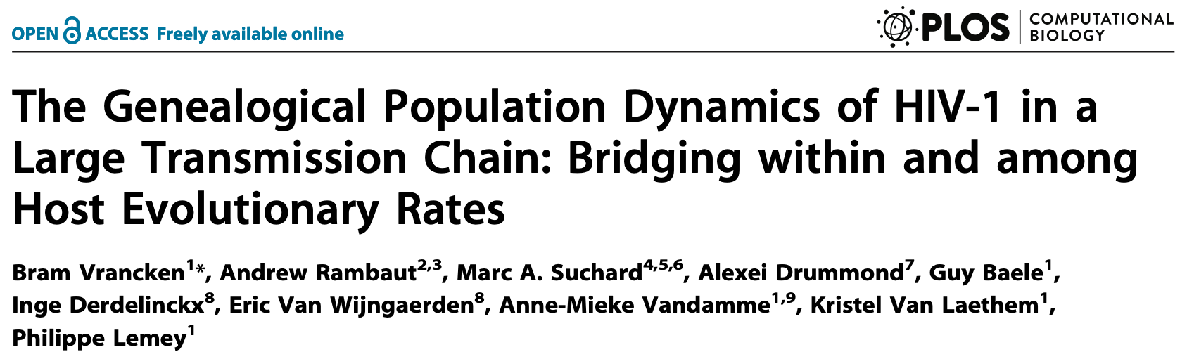
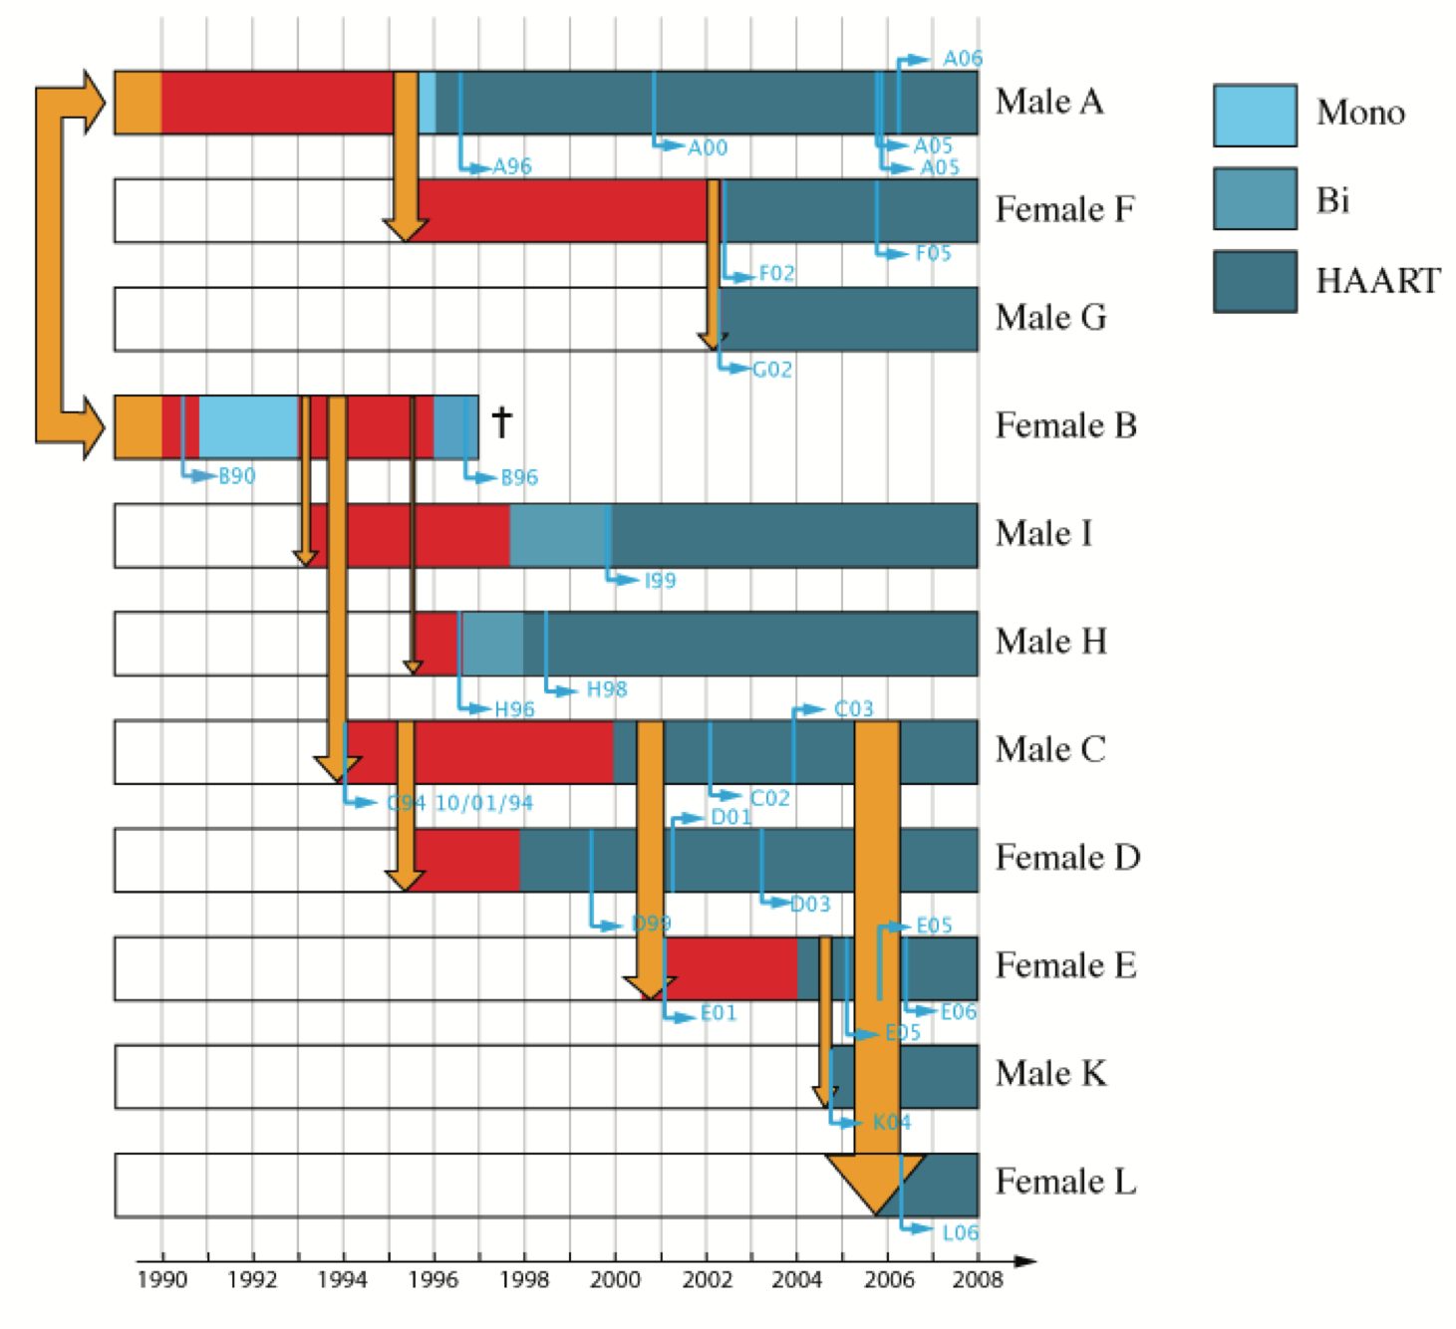
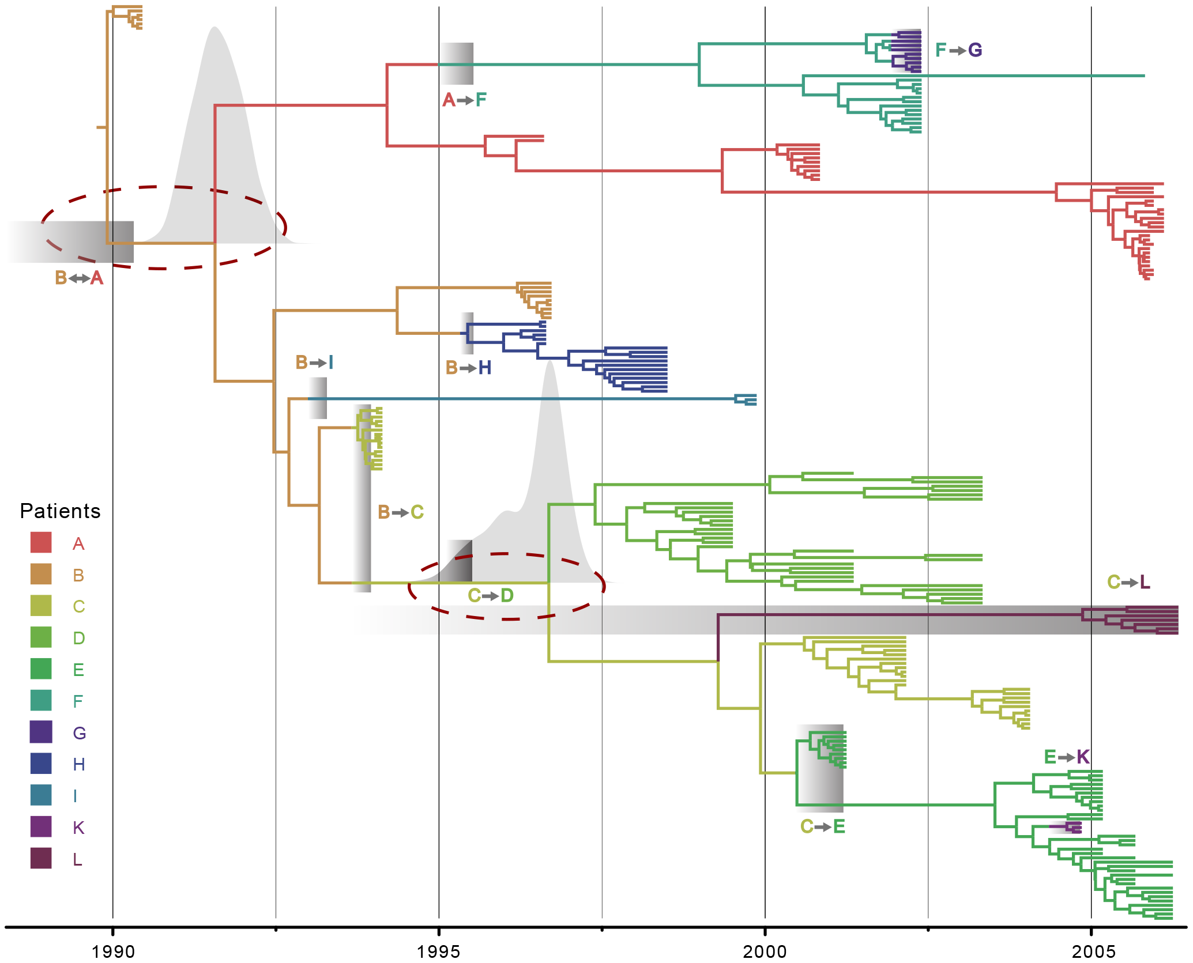

Slide 24
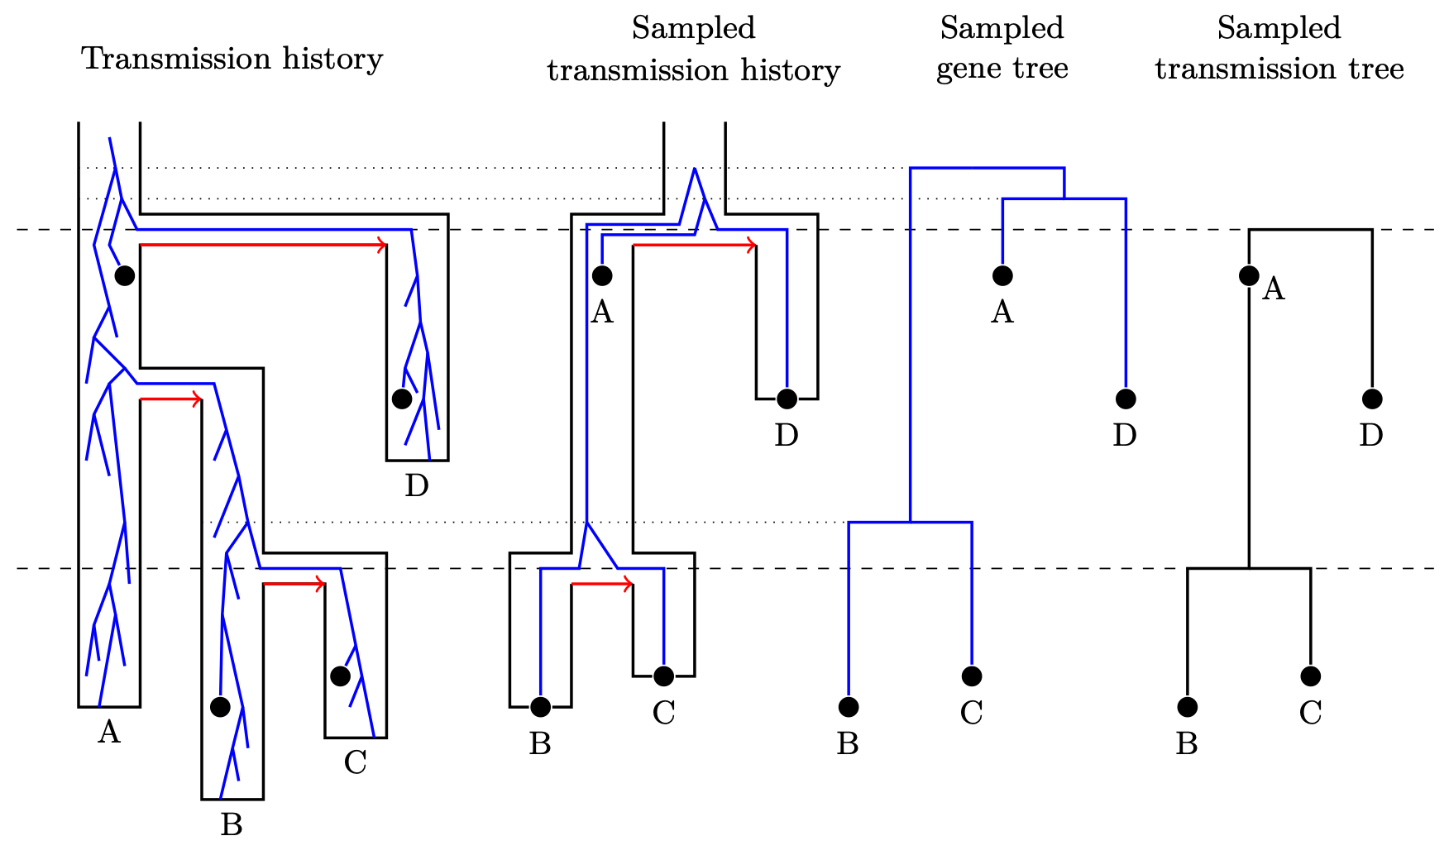
Pathogen evolution inside transmission trees
Goal: An integrated model of stochastic infection dynamics and viral genomic evolution. Integrating infection dynamics and genomic sequence evolution into a single model.

Slide 25
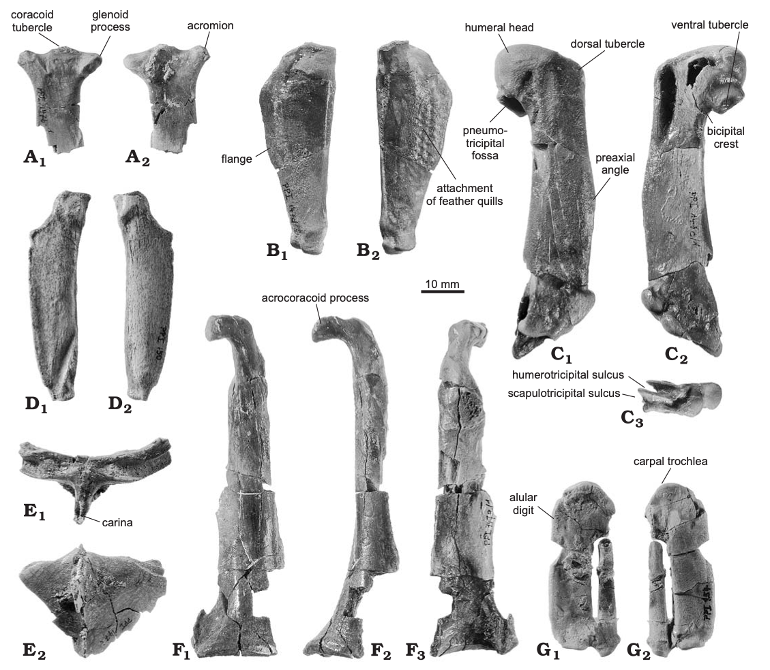
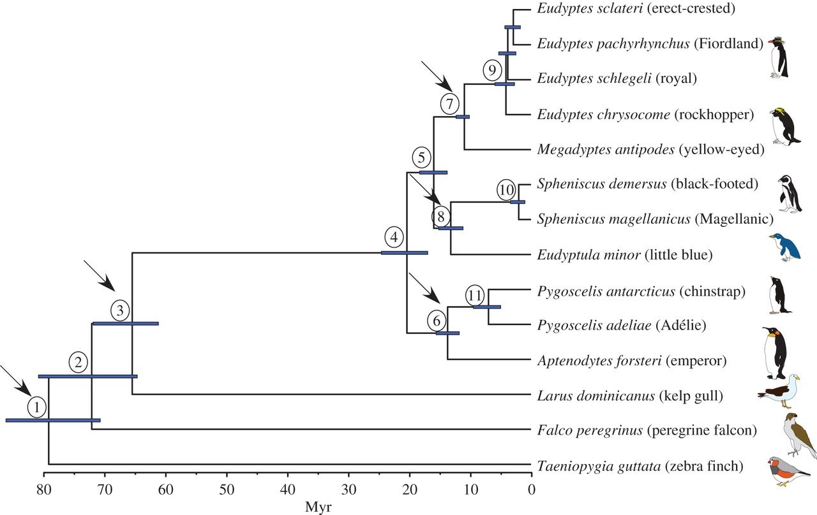
Phylogenies and the fossil record
An example of node dating with BEAST from Subramanian et al (Biology Letters, 2013)
Notes:
A common practice is node dating, where one or more divergences in a phylogeny are assigned ages by identifying fossils of known geological age that correspond to each divergence.
This method has drawbacks:
Often only the oldest fossil in a calibrated clade is used
Calibration densities often ad hoc
It is difficult to combine multiple independent fossil constraints
Computational complexity of some methods means that only a few nodes can be calibrated (Heled and Drummond, 2012)

Slide 26
Total evidence fossil dating
We have
molecular data of extant species
morphological data of extant and extinct species
fossil ages (or geological time intervals)
We want to use all this data to learn about evolutionary history and macroevolutionary processes
Bayesian statistical inference is our preferred method for learning about the world.

Slide 27
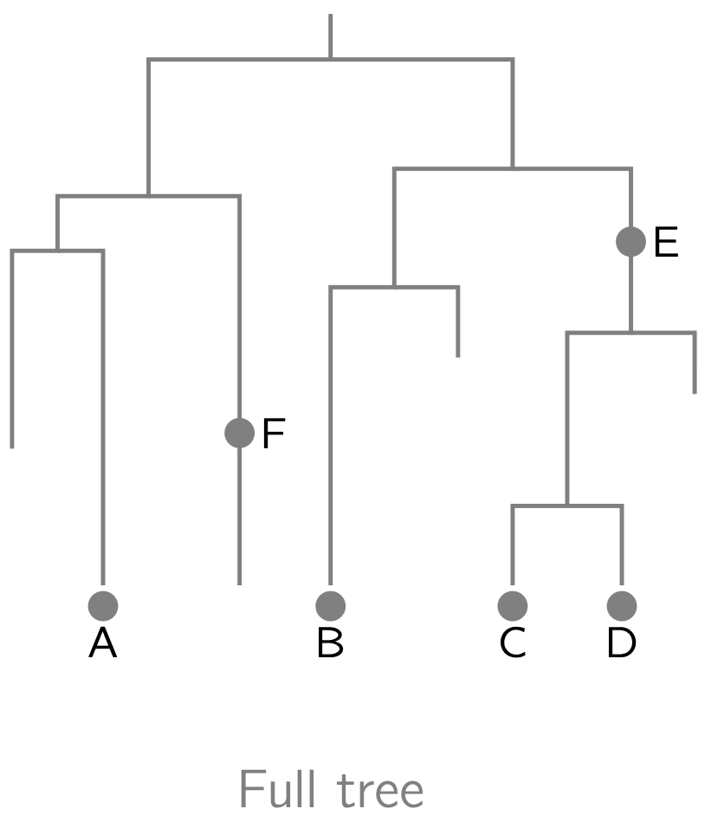
Fossilized birth-death (FBD) model
Stadler 2010, Gavryushkina et al 2014
The process starts at time t_{or} > 0 and ends at time zero (present time).
birth rate λ
death rate μ
sampling rate ψ
sampling at present probability ρ
Model parameters: η = (t_{or}, λ, μ, ψ, ρ).
All the parameters are identifiable.

Slide 28
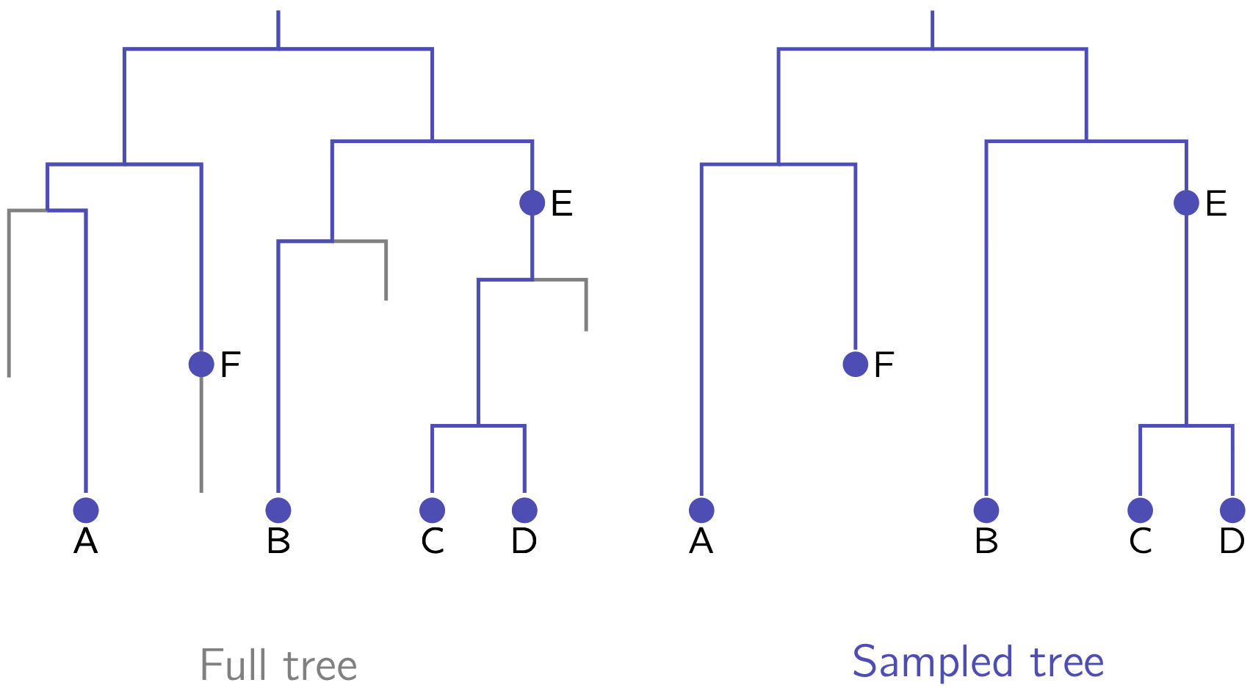
Fossilized birth-death (FBD) model

Slide 29
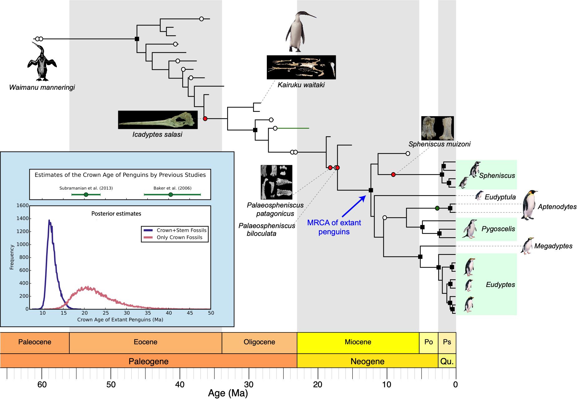
Computer models of DNA and fossils

Slide 30
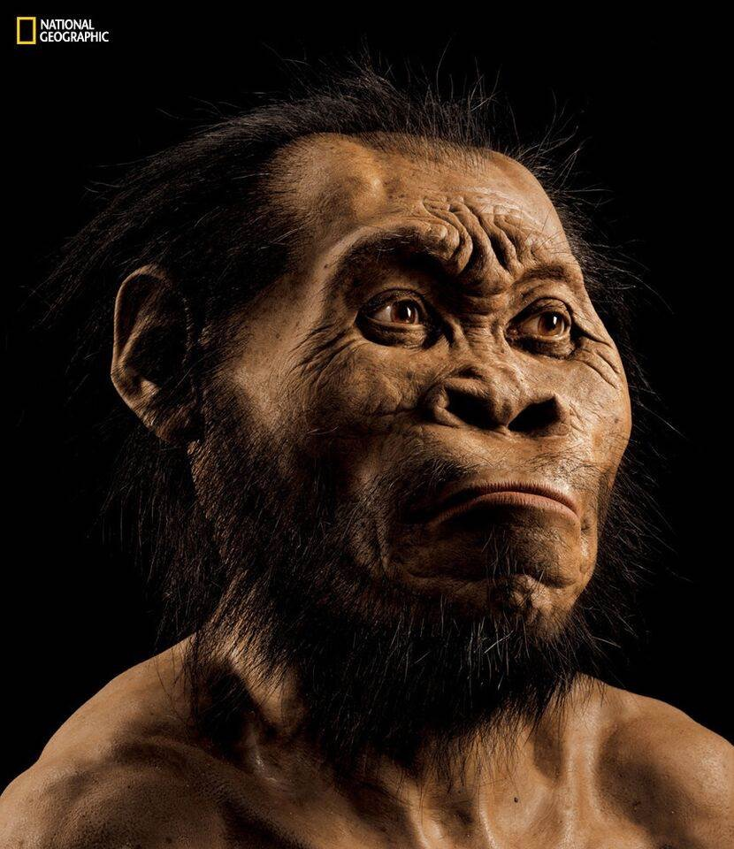
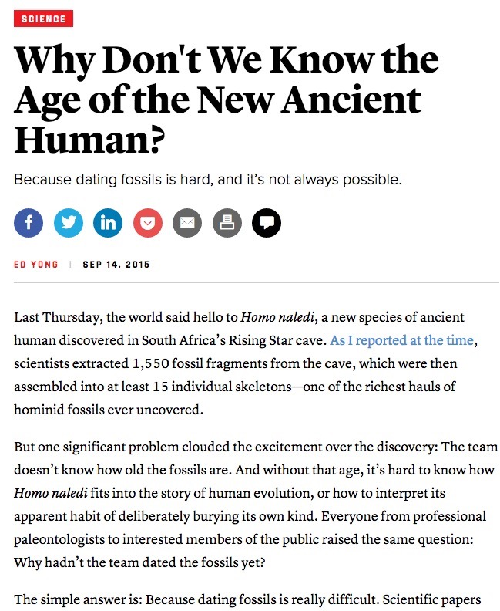
Human evolution and Homo naledi

Slide 31
Can we date fossils using Bayesian phylogenetics?
Given
A reference set of fossils of known age, and
A morphological characterization for reference fossils, and
The FBD model of sampled ancestor trees
A “clock-like” model of morphological evolution
A morphological characterization of a related focal fossil of unknown age
Can the age of the focal fossil be estimated using Bayesian phylogenetic inference?
I tested this hypothesis on a penguin data set including 36 penguin fossils under a simple model of morphological evolution (M1) and a complex model (M8).

Slide 32
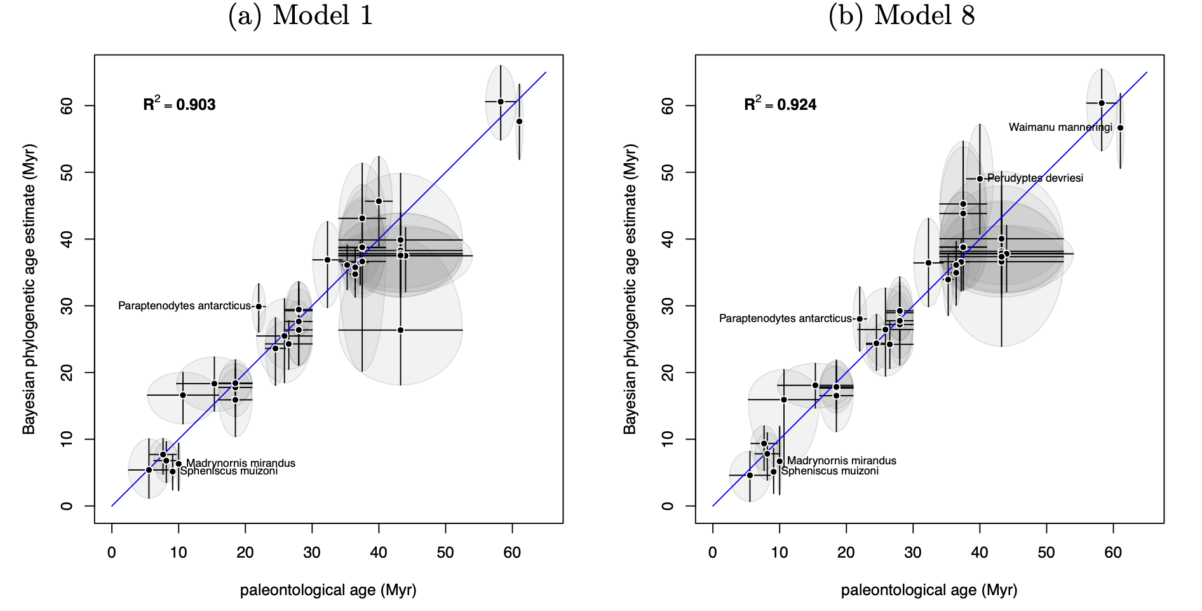
Estimating the phylogenetic age of a fossil
Bayesian phylogenetic age estimates for each of 36 penguin fossils plotted against their palaeontological age ranges.

Slide 33
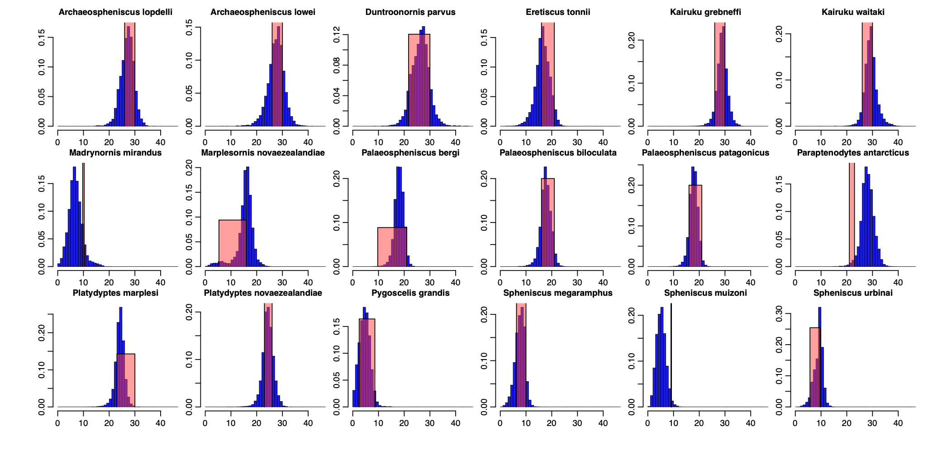
Estimating the phylogenetic age of a fossil
Marginal posterior histograms for phylogenetic age estimates of each of the 18 penguin fossils younger than 30Myr using M8.

Slide 34
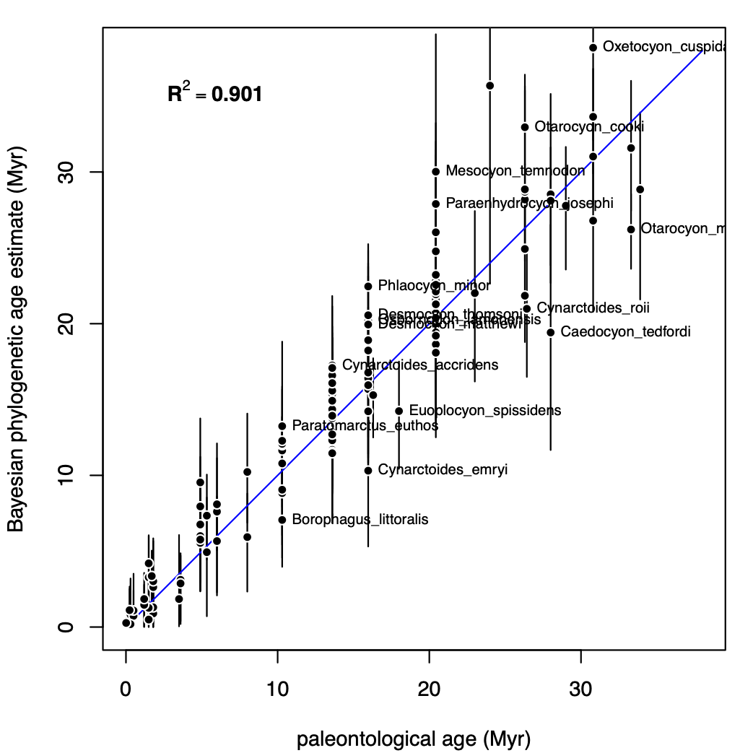
123 Canid fossils
Bayesian phylogenetic ages for each of 123 canid fossils plotted against palaeontological ages, under M1.

Slide 35
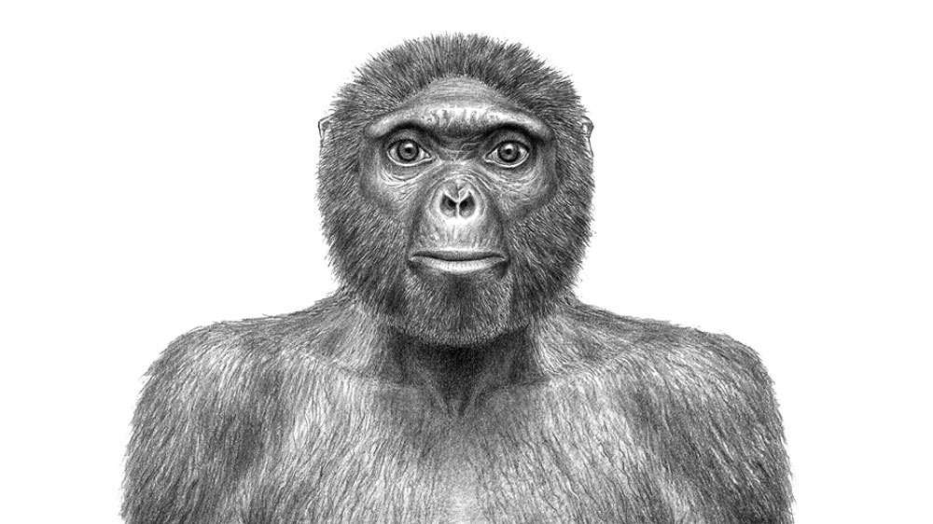
Controversies in human evolution: Ardipithecus ramidus
“Ardi”, 4.4My old species was described as the oldest fossil relative on the human lineage, a hominin.

Slide 36
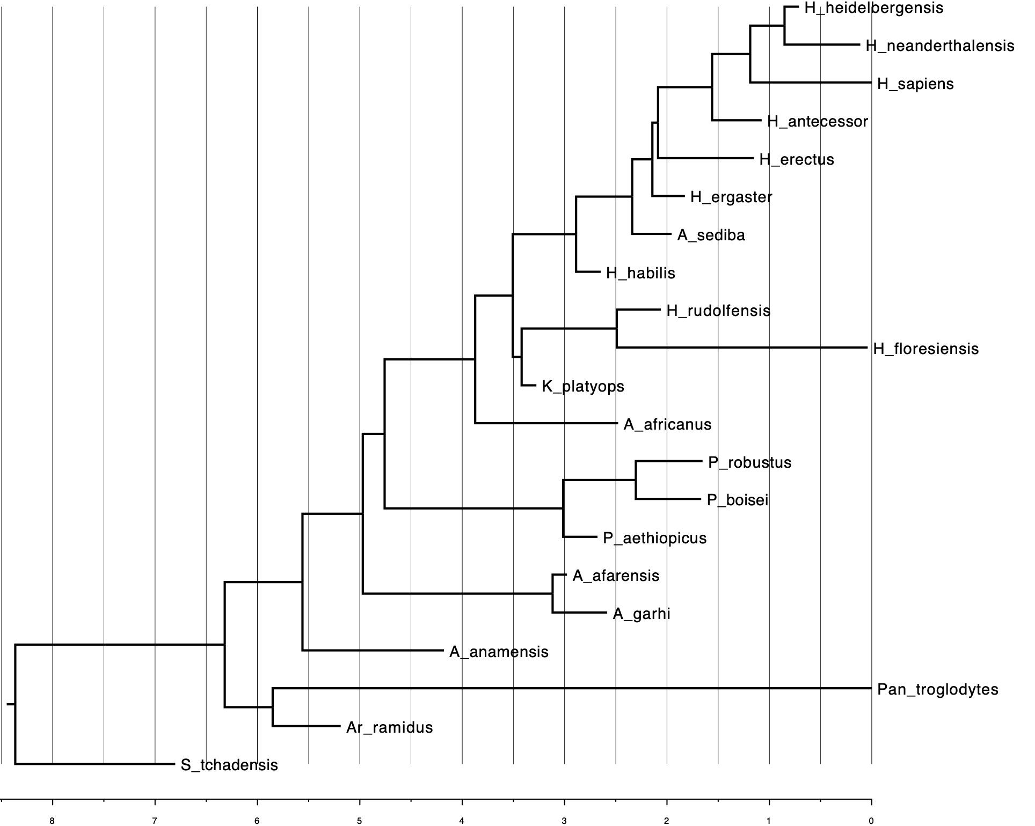

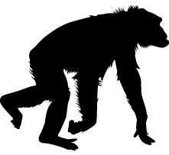
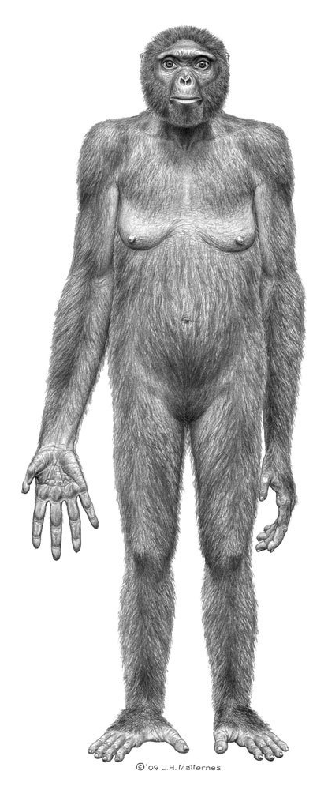
Ardi more closely related to chimpanzee?

Slide 37
Final Perspectives
Evolutionary biology has become a multidisciplinary analytical science, with major input from computer scientists, statisticians, mathematicians and physicists.
Evolutionary biology is not just an historical science. Rapidly evolving natural systems, low-cost high-throughput sequencing and high-throughput automated experimental evolution platforms, all add up to the potential to close the loop between experimental and theoretical evolutionary biology.
A common set of evolutionary modelling principles can inform us on diverse questions including human population history, recombination rates in E. coli and the age of fossils.

